Slide 1
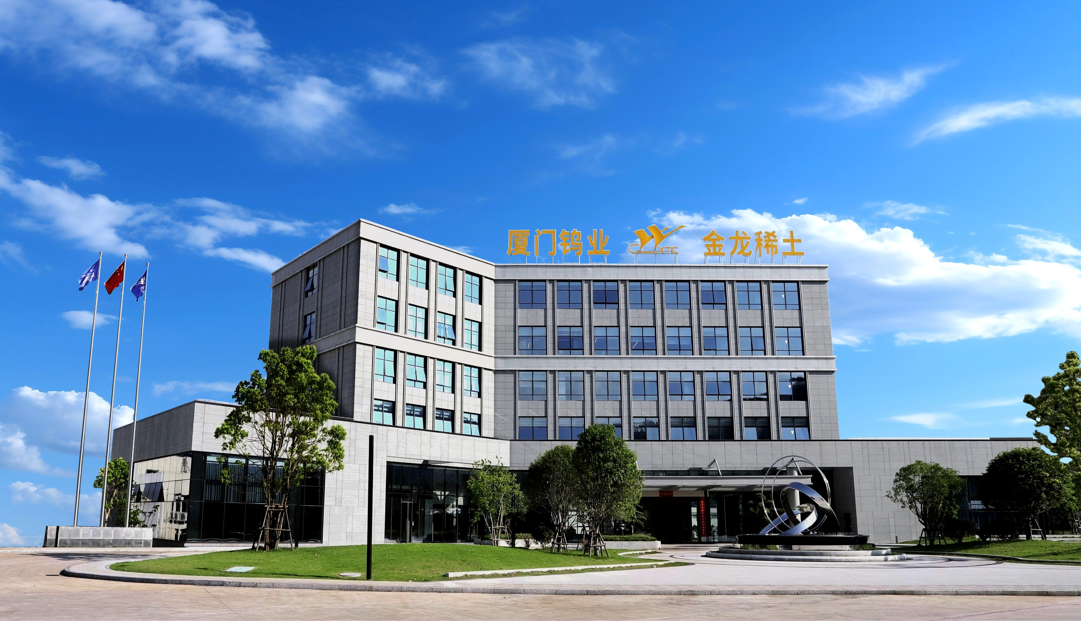
稀土永磁材料产业发展现状与展望
Current Status and Prospects of Rare Earth Permanent
Magnet Materials Industry
Alex Shi Fujian Golden Dragon Rare-Earth Co., Ltd.
师大伟

Slide 2
Main Content
1 Development history and industrial landscape of rare earth permanent
magnetic materials.
2 Current supply and demand situation of rare earth permanent magnetic materials.
3 Development trend of rare earth permanent magnetic materials.
4 Prospects of rare earth permanent magnetic materials market.

